Slide 3
Standards for Worksheet/PowerPoint Activities
SC.2.L.16.1 Observe and describe major stages in the life cycles of plants and animals, including beans and butterflies.
SC.1.L.14.2Identify the major parts of plants, including stem, roots, leaves, and flowers.
SC.3.L.17.2. Recognize that plants use energy from the Sun, air, and water to make their own food.
CTE-AFNR.68.PLANT.02.05. Develop a specimen collection of local plant materials.
SC.1.L.16.1 Make observations that plants and animals closely resemble their parents, but variations exist among individuals within a population.
SC.1.L.17.1. Through observation, recognize that all plants and animals, including humans, need the basic necessities of air, water, food, and space.
SC.K.L.14.2. Recognize that some books and other media portray animals and plants with characteristics and behaviors they do not have in real life.
SC.K.L.14.3. Observe plants and animals, describe how they are alike and how they are different in the way they look and in the things they do.
SC.1.N.1.3. Keep records as appropriate - such as pictorial and written records - of investigations conducted.
LAFS.K.W.1.2. Use a combination of drawing, dictating, and writing to compose informative/explanatory texts in which they name what they are writing about and supply some information about the topic.
SP.PK12.US.1.3c. Apply skills and strategies in written communication, including setting a purpose for writing, creating complete simple and complex sentences, and organizing information into different types of paragraphs and essays.
LAFS.1.W.1.1. Write opinion pieces in which they introduce the topic or name the book they are writing about, state an opinion, supply a reason for the opinion, and provide some sense of closure.
LAFS.K12.L.1.1. Demonstrate command of the conventions of standard English grammar and usage when writing or speaking.
WL.K12.IH.5.5. Describe, in writing, events in chronological order.
ELA.1.C.1.4 Write expository texts about a topic, using a source, providing facts and a sense of closure.
ELA.1.C.1.5. With guidance and support from adults, improve writing, as needed, by planning, revising, and editing.
ELA.1.V.1.1. Use grade-level academic vocabulary appropriately in speaking and writing.
ELA.K.C.1.4. Using a combination of drawing, dictating, and/or writing, provide factual information about a topic.
LAFS.K12.L.1.2 Demonstrate command of the conventions of standard English capitalization, punctuation, and spelling when writing.
WL.K12.NM.2.1. Demonstrate understanding of written familiar words, phrases, and simple sentences supported by visuals.
WL.K12.NM.5.1. Provide basic information in writing using familiar topics, often using previously learned expressions and phrases.
WL.K12.NM.5.6. Pre-write by drawing pictures to support ideas related to a task.
WL.K12.IH.5.7. Write a short essay or biography using descriptive details and a variety of sentence structure.
WL.K12.IL.5.1. Write on familiar topics and experiences using main ideas and supporting details.
WL.K12.IM.5.1. Write narratives on familiar topics using logically connected sentences with supporting details.
MA.1.NSO.1.1. Starting at a given number, count forward and backwards within 120 by ones. Skip count by 2s to 20 and by 5s to 100.
MA.K.NSO.1.2 Given a number from 0 to 20, count out that many objects.
MA.K.NSO.2.1. Recite the number names to 100 by ones and by tens. Starting at a given number, count forward within 100 and backward within 20.
IMAFS.K.CC.3.6. Identify whether the number of objects in one group is greater than, less than, or equal to the number of objects in another group, e.g., by using matching and counting strategies.
MAFS.K.CC.1.3 Read and write numerals from 0 to 20. Represent a number of objects with a written numeral 0–20 (with 0 representing a count of no objects).
SS.K.E.1.1 Describe different kinds of jobs that people do and the tools or equipment used.
G.K12.1.3.1b Skill Development - Understand: Compare and contrast job descriptions, methods of working, and challenges faced by various practicing professionals to determine relevance to personal needs and goals.
www.firstchurchpo.org

Slide 4
Additional Resources
How Big Could Your Pumpkin Grow? by Wendell Minor
How Many Seeds In A Pumpkin? by Margaret McNamara
See, Sprout, Pumpkin, Pie by Jill Esbaum
The Pumpkin Book by Gail Gibbons
www.firstchurchpo.org

Slide 6
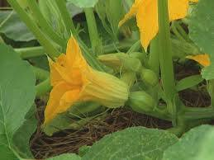
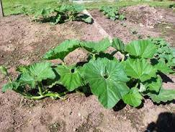
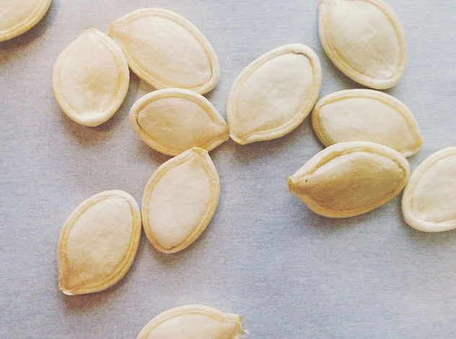
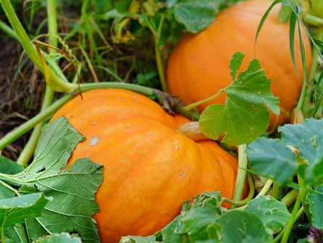
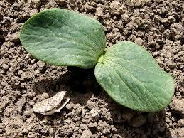
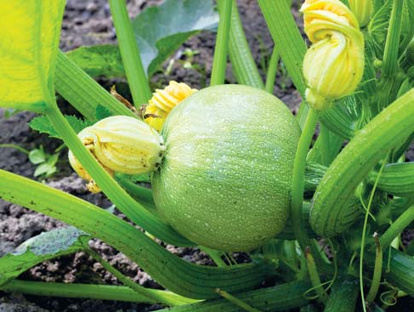

Slide 8
Orange Pumpkin
Sprout
Flower
Pumpkin
Vine
Green Pumpkin
Seed

