Slide 1
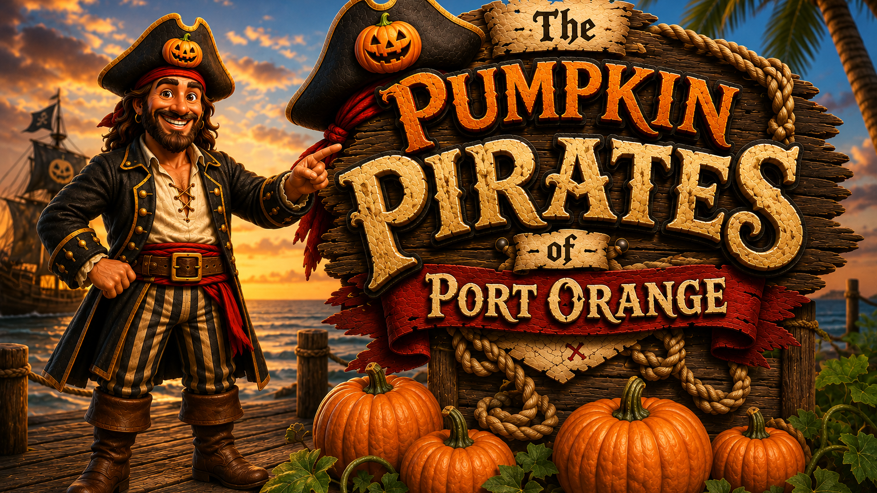
2026 TEACHER INTERACTIVE
Pumpkin science, math, writing, and pirate treasure challenges
Notes:
Interactive pieces remain editable and movable in PowerPoint Normal view.

Slide 2
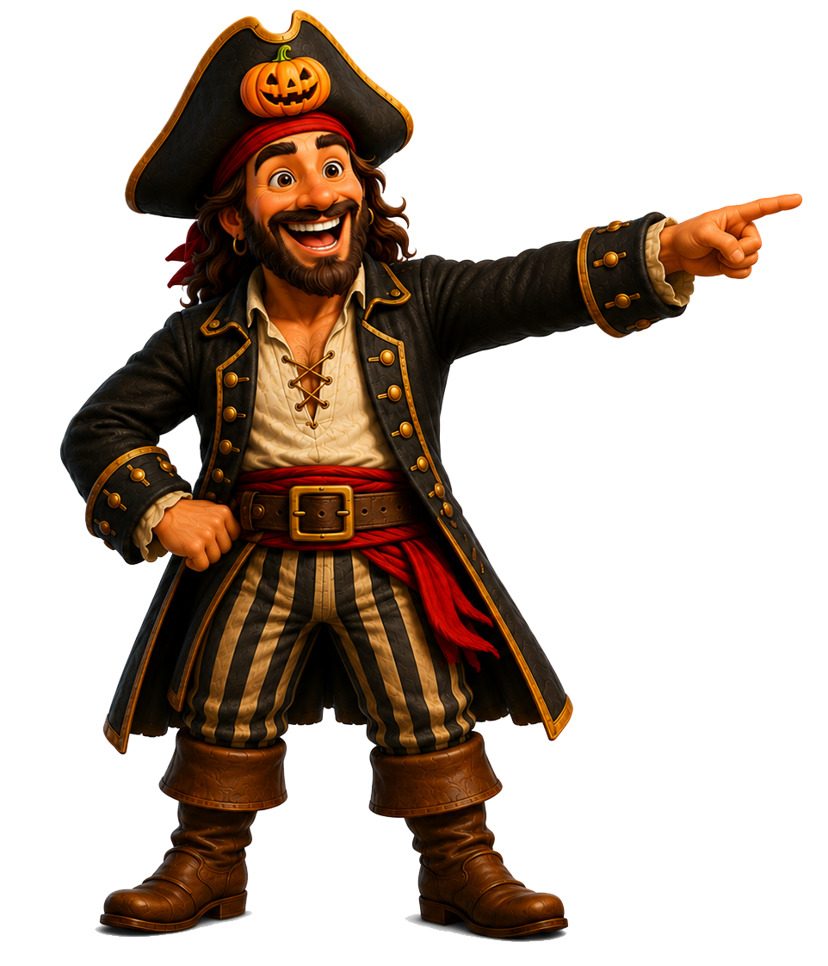
Learning goals and standards
TEACHER MAP
Students will explore
SC.2.L.16.1 Observe and describe major stages in the life cycles of plants and animals, including beans and butterflies.
SC.1.L.14.2Identify the major parts of plants, including stem, roots, leaves, and flowers.
SC.3.L.17.2. Recognize that plants use energy from the Sun, air, and water to make their own food.
CTE-AFNR.68.PLANT.02.05. Develop a specimen collection of local plant materials.
SC.1.L.16.1 Make observations that plants and animals closely resemble their parents, but variations exist among individuals within a population.
SC.1.L.17.1. Through observation, recognize that all plants and animals, including humans, need the basic necessities of air, water, food, and space.
SC.K.L.14.2. Recognize that some books and other media portray animals and plants with characteristics and behaviors they do not have in real life.
SC.K.L.14.3. Observe plants and animals, describe how they are alike and how they are different in the way they look and in the things they do.
SC.1.N.1.3. Keep records as appropriate - such as pictorial and written records - of investigations conducted.
LAFS.K.W.1.2. Use a combination of drawing, dictating, and writing to compose informative/explanatory texts in which they name what they are writing about and supply some information about the topic.
SP.PK12.US.1.3c. Apply skills and strategies in written communication, including setting a purpose for writing, creating complete simple and complex sentences, and organizing information into different types of paragraphs and essays.
LAFS.1.W.1.1. Write opinion pieces in which they introduce the topic or name the book they are writing about, state an opinion, supply a reason for the opinion, and provide some sense of closure.
LAFS.K12.L.1.1. Demonstrate command of the conventions of standard English grammar and usage when writing or speaking.
WL.K12.IH.5.5. Describe, in writing, events in chronological order.
ELA.1.C.1.4 Write expository texts about a topic, using a source, providing facts and a sense of closure.
ELA.1.C.1.5. With guidance and support from adults, improve writing, as needed, by planning, revising, and editing.
ELA.1.V.1.1. Use grade-level academic vocabulary appropriately in speaking and writing.
ELA.K.C.1.4. Using a combination of drawing, dictating, and/or writing, provide factual information about a topic.
LAFS.K12.L.1.2 Demonstrate command of the conventions of standard English capitalization, punctuation, and spelling when writing.
WL.K12.NM.2.1. Demonstrate understanding of written familiar words, phrases, and simple sentences supported by visuals.
WL.K12.NM.5.1. Provide basic information in writing using familiar topics, often using previously learned expressions and phrases.
WL.K12.NM.5.6. Pre-write by drawing pictures to support ideas related to a task.
WL.K12.IH.5.7. Write a short essay or biography using descriptive details and a variety of sentence structure.
WL.K12.IL.5.1. Write on familiar topics and experiences using main ideas and supporting details.
WL.K12.IM.5.1. Write narratives on familiar topics using logically connected sentences with supporting details.
MA.1.NSO.1.1. Starting at a given number, count forward and backwards within 120 by ones. Skip count by 2s to 20 and by 5s to 100.
MA.K.NSO.1.2 Given a number from 0 to 20, count out that many objects.
MA.K.NSO.2.1. Recite the number names to 100 by ones and by tens. Starting at a given number, count forward within 100 and backward within 20.
IMAFS.K.CC.3.6. Identify whether the number of objects in one group is greater than, less than, or equal to the number of objects in another group, e.g., by using matching and counting strategies.
MAFS.K.CC.1.3 Read and write numerals from 0 to 20. Represent a number of objects with a written numeral 0–20 (with 0 representing a count of no objects).
SS.K.E.1.1 Describe different kinds of jobs that people do and the tools or equipment used.
G.K12.1.3.1b Skill Development - Understand: Compare and contrast job descriptions, methods of working, and challenges faced by various practicing professionals to determine relevance to personal needs and goals.
First Church Port Orange • 2026
Pumpkins are the treasure!
Notes:
Interactive pieces remain editable and movable in PowerPoint Normal view.

Slide 3
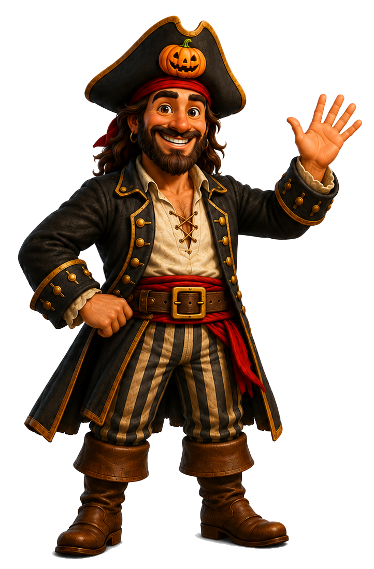
Books for the crew
READ ALOUDS
Choose one title before your visit. Ask students to listen for new pumpkin facts.
1
2
3
4
Treasure question:
What fact did you find?
Treasure question:
What fact did you find?
Treasure question:
What fact did you find?
Treasure question:
What fact did you find?
First Church Port Orange • 2026
Pumpkins are the treasure!
Notes:
Interactive pieces remain editable and movable in PowerPoint Normal view.

Slide 4
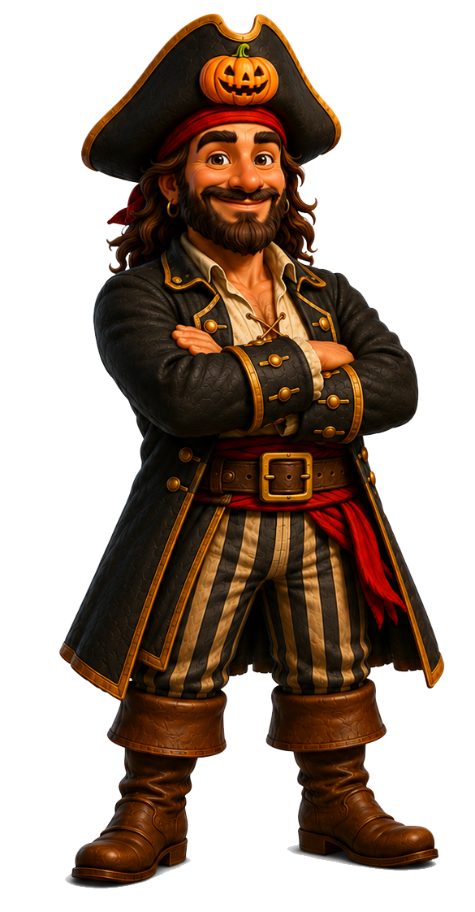
Fact or pirate tale?
WARM-UP
Drag one gold coin to TRUE or FALSE for each statement.
1. Pumpkins grow on trees.
TRUE
FALSE
2. People can eat pumpkins.
TRUE
FALSE
3. Pumpkins begin as seeds.
TRUE
FALSE
4. Pumpkins are only orange and round.
TRUE
FALSE
First Church Port Orange • 2026
Pumpkins are the treasure!
Notes:
Interactive pieces remain editable and movable in PowerPoint Normal view.

Slide 5
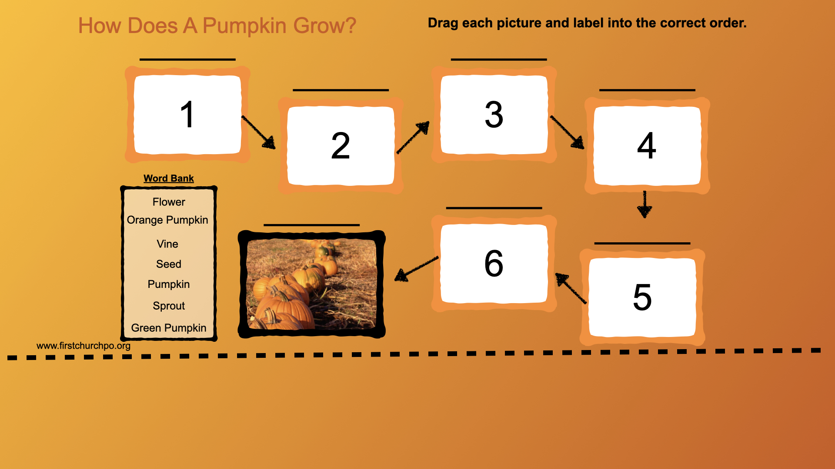
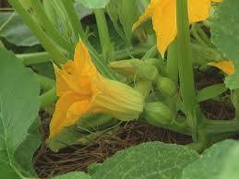
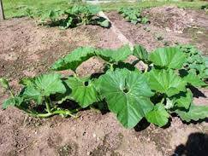
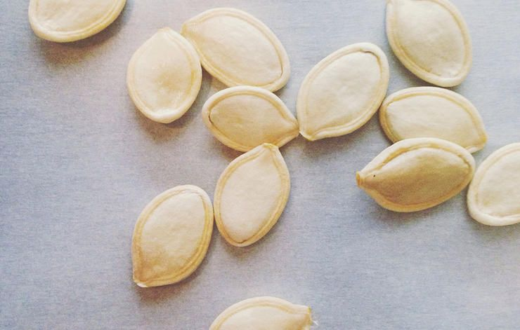
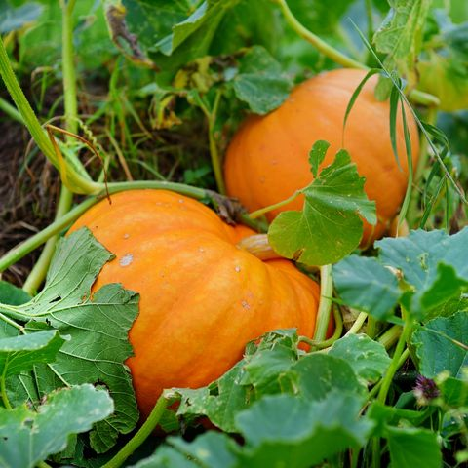
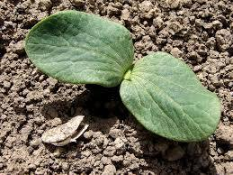
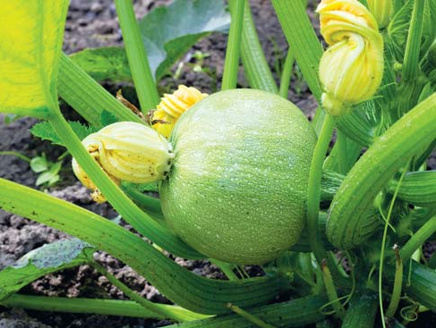
Flower
Orange Pumpkin
Vine
Seed
Pumpkin
Sprout
Green Pumpkin

Slide 6
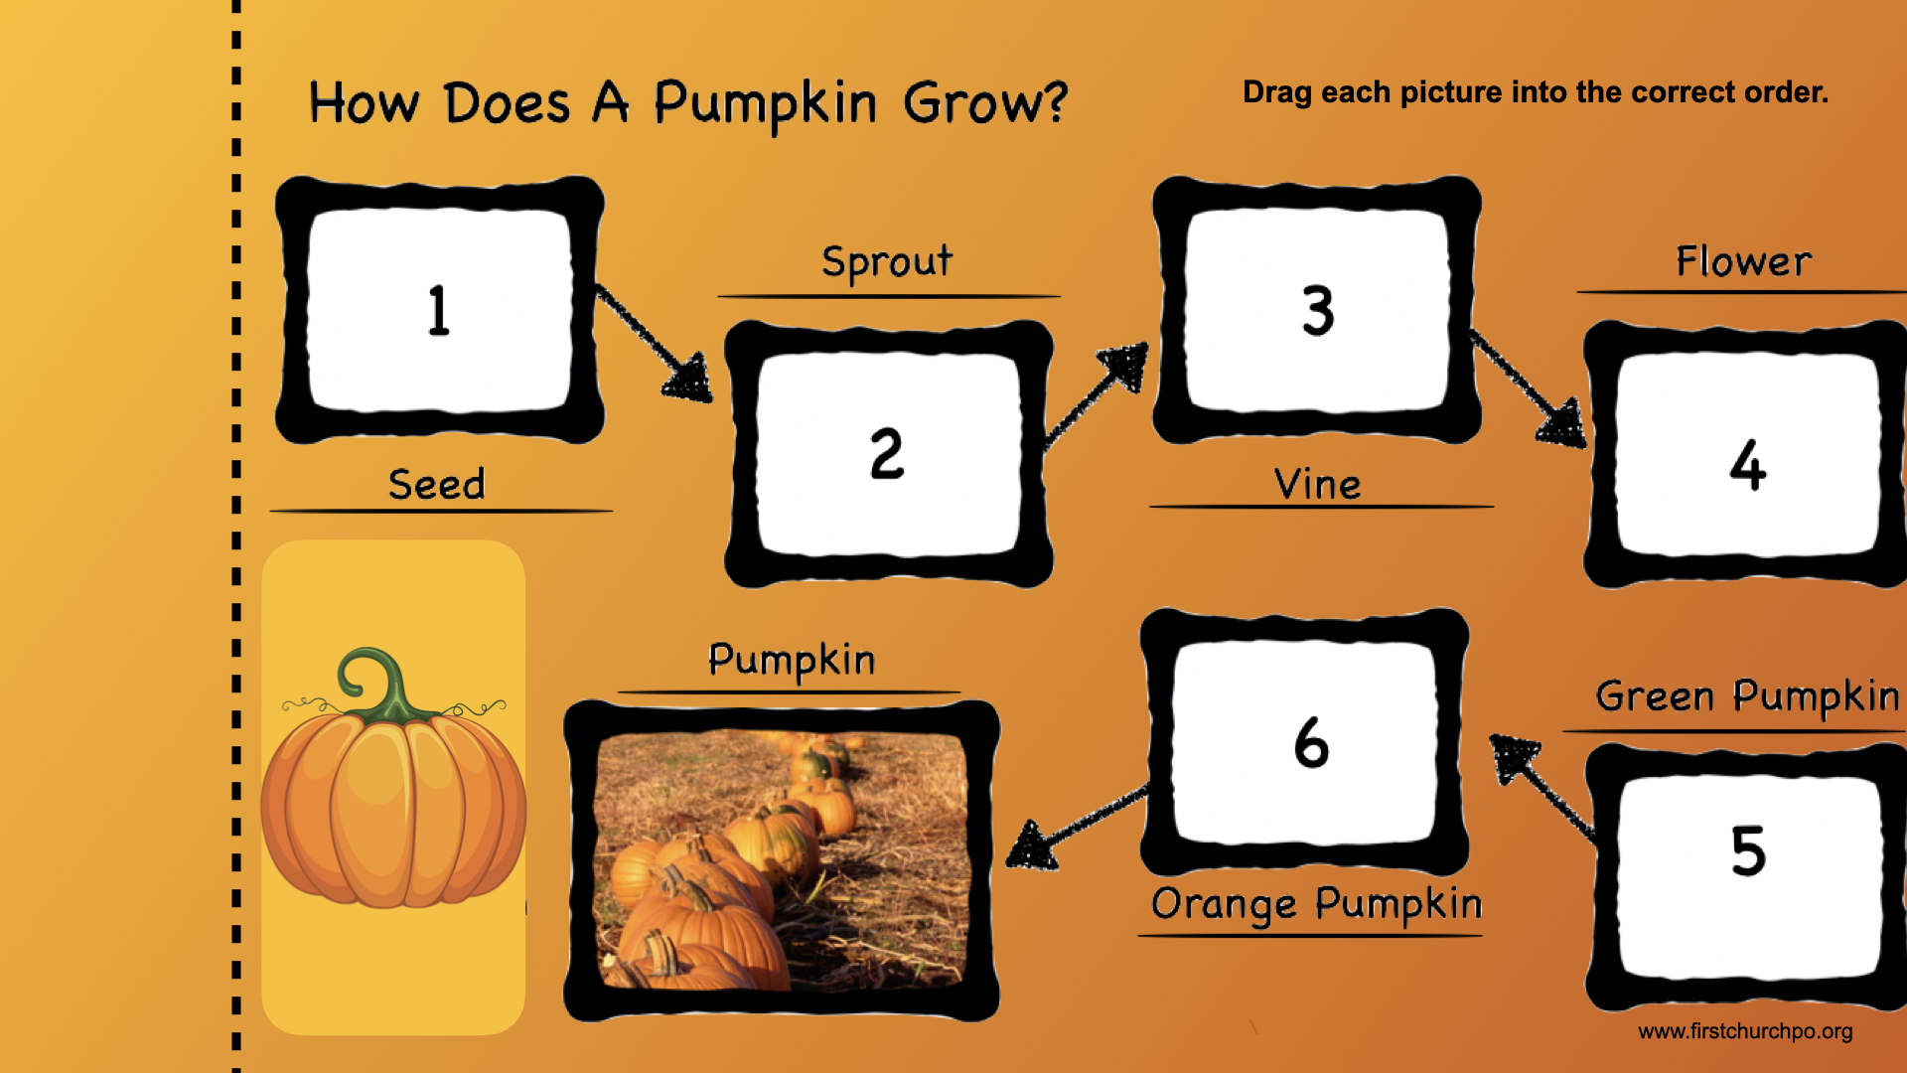

Slide 7
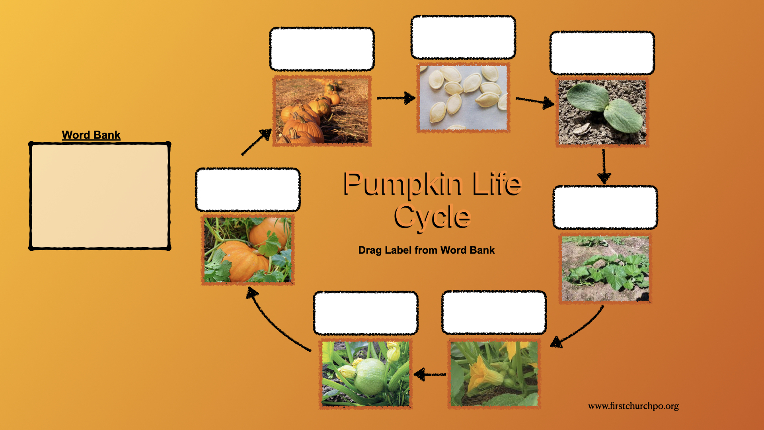
Orange Pumpkin
Sprout
Flower
Pumpkin
Vine
Green Pumpkin
Seed

Slide 8
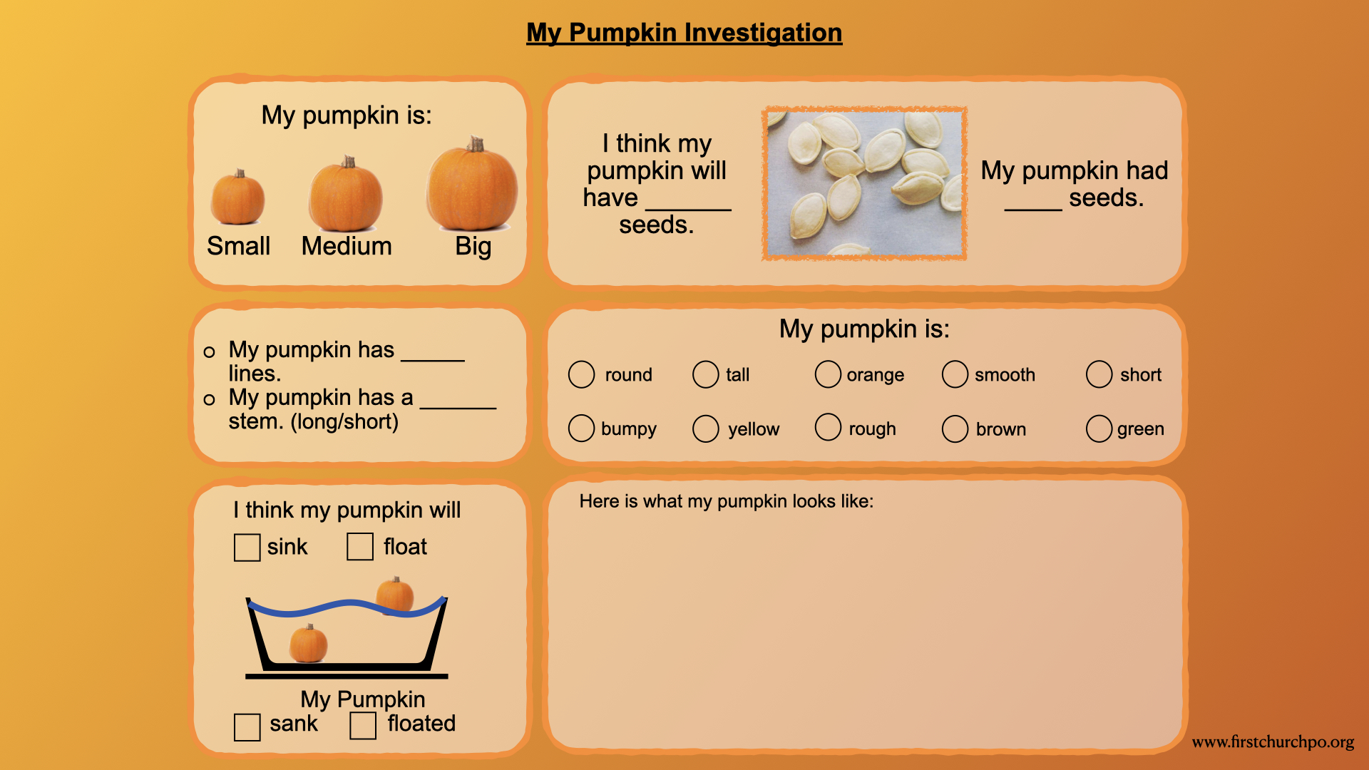

Slide 9
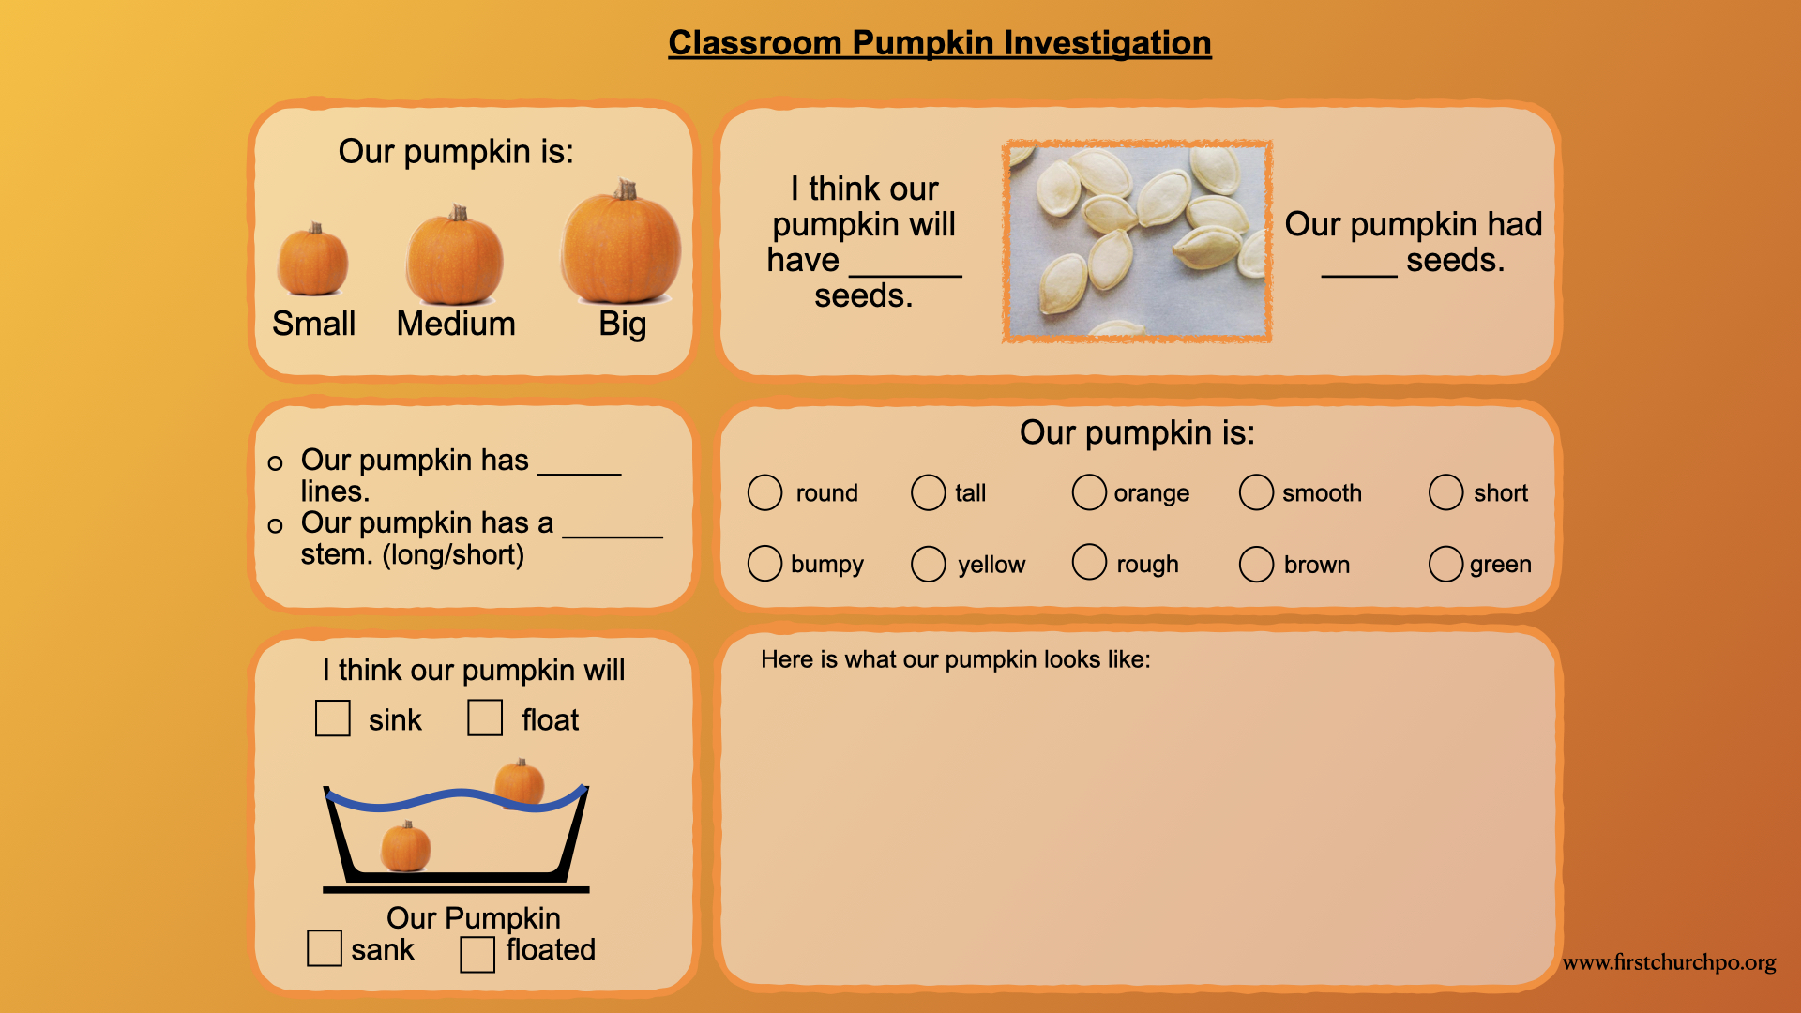

Slide 10
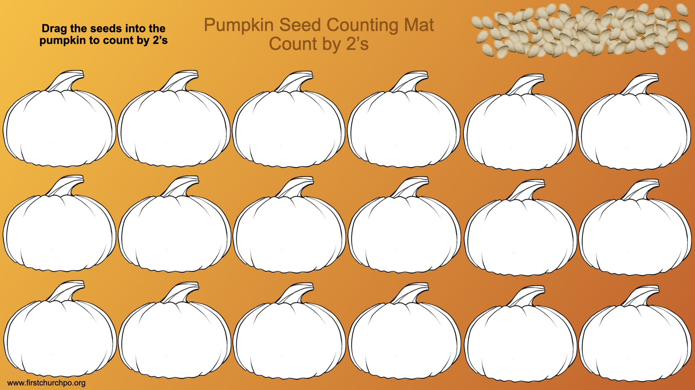
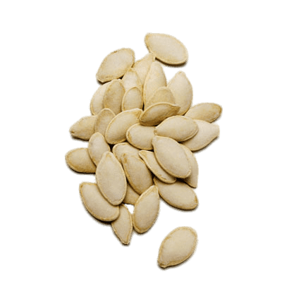

Slide 11
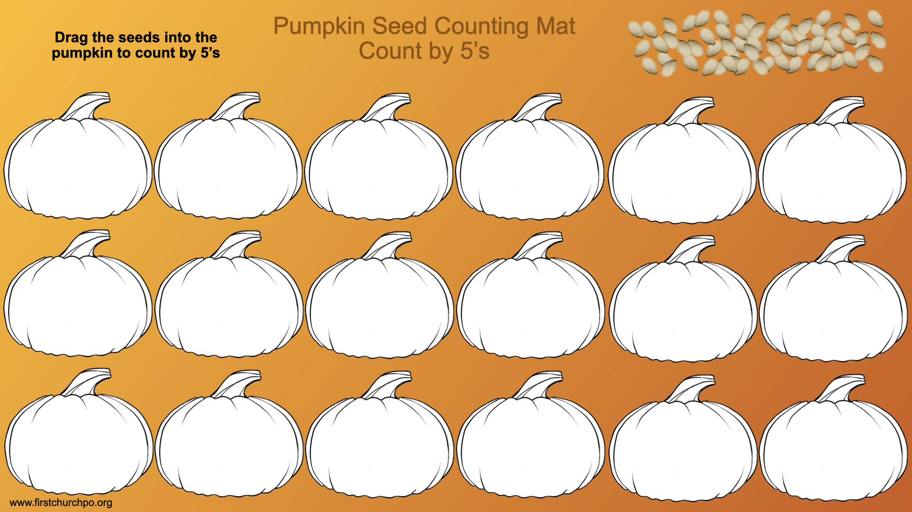

Slide 12
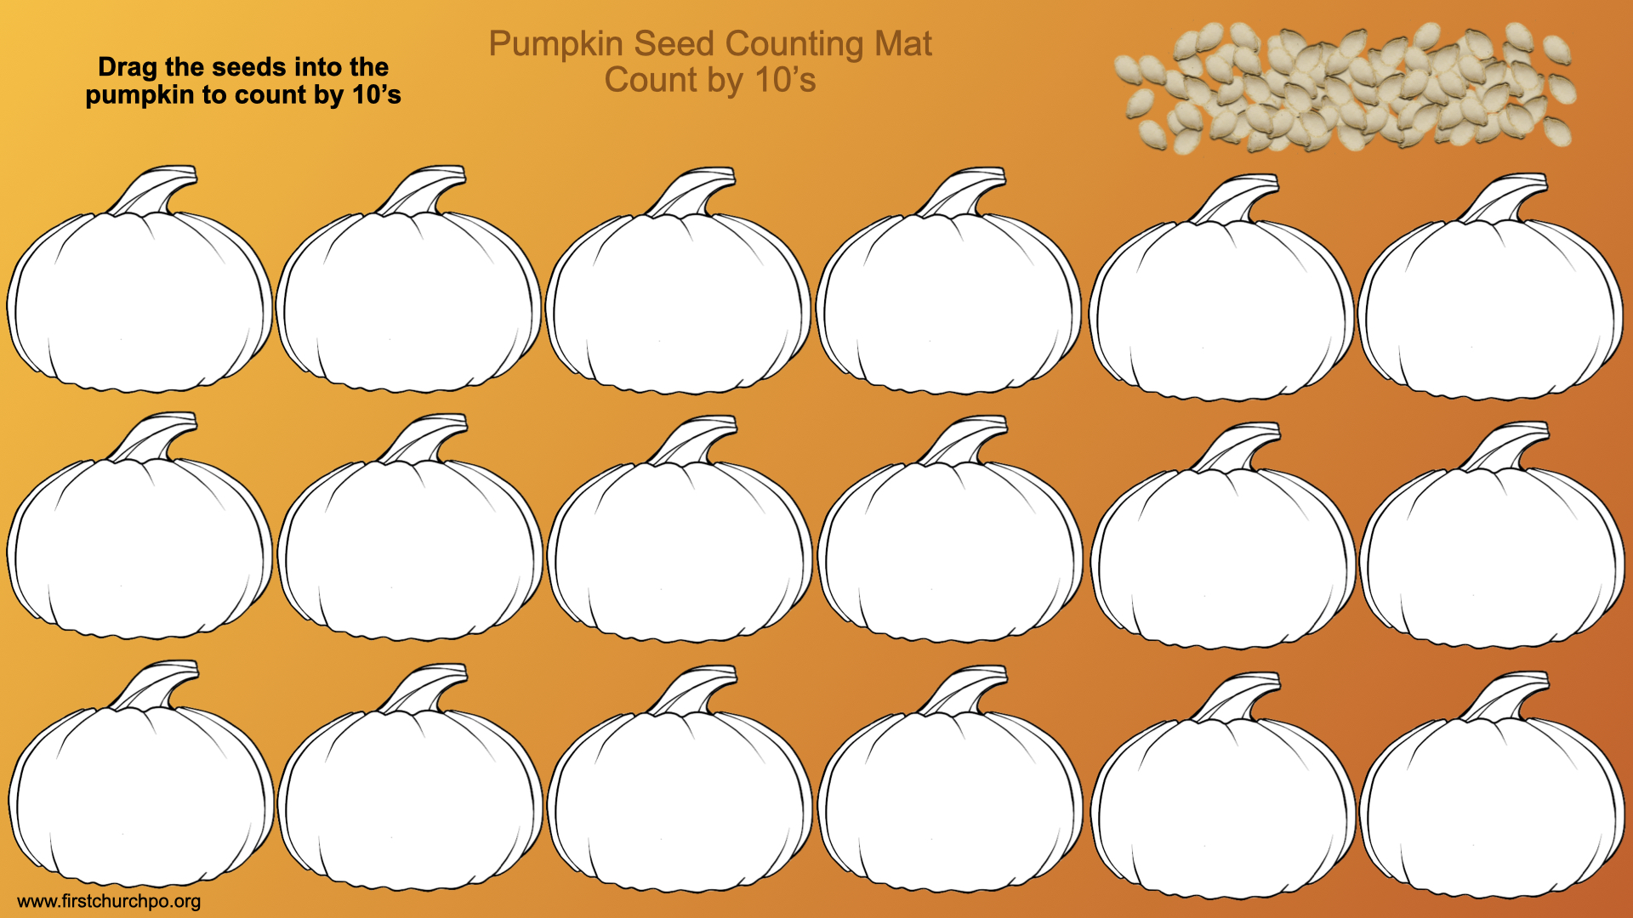

Slide 13
Pirate vocabulary tracing
EARLY WRITING
Trace each word, say it aloud, then circle the stage that comes first.
Pumpkin
Stem
Seed
Vine
Flower
First Church Port Orange • 2026
Pumpkins are the treasure!
Notes:
Interactive pieces remain editable and movable in PowerPoint Normal view.

Slide 14
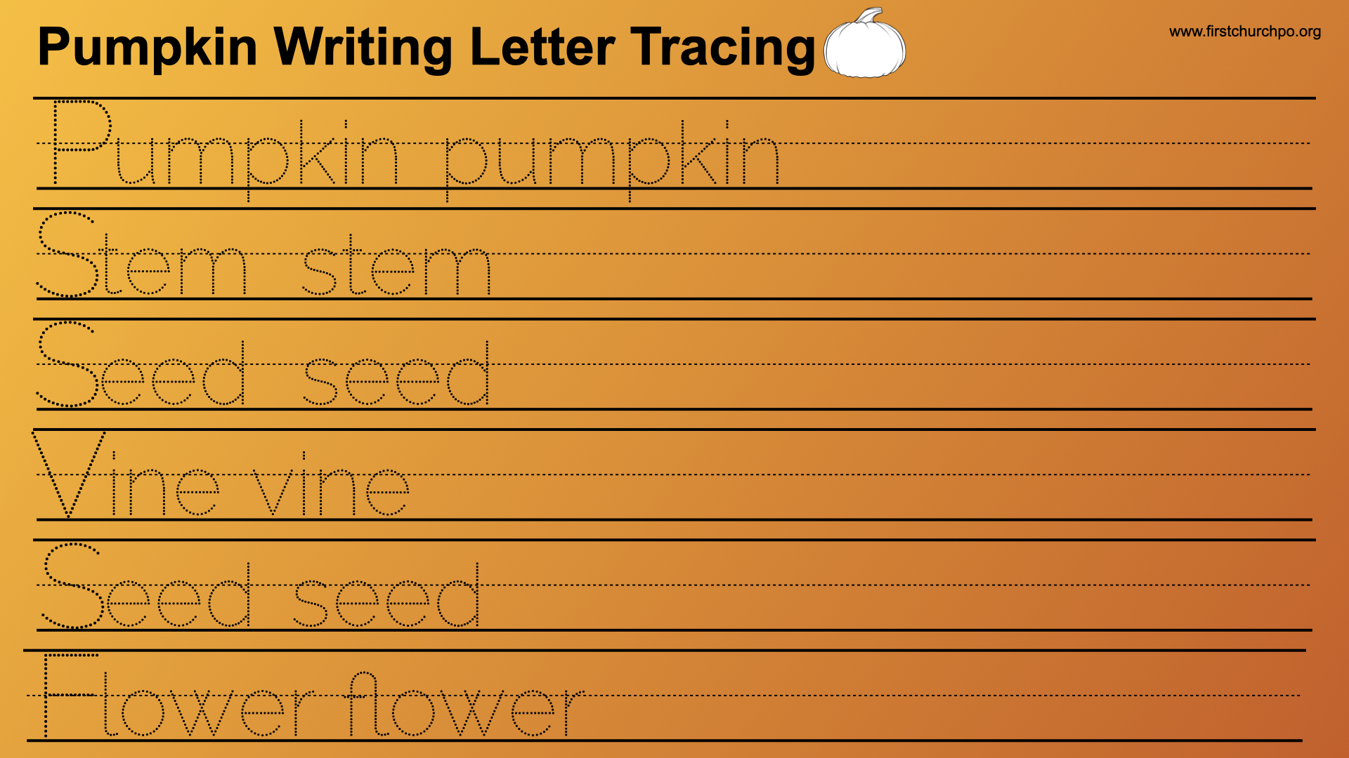

Slide 15
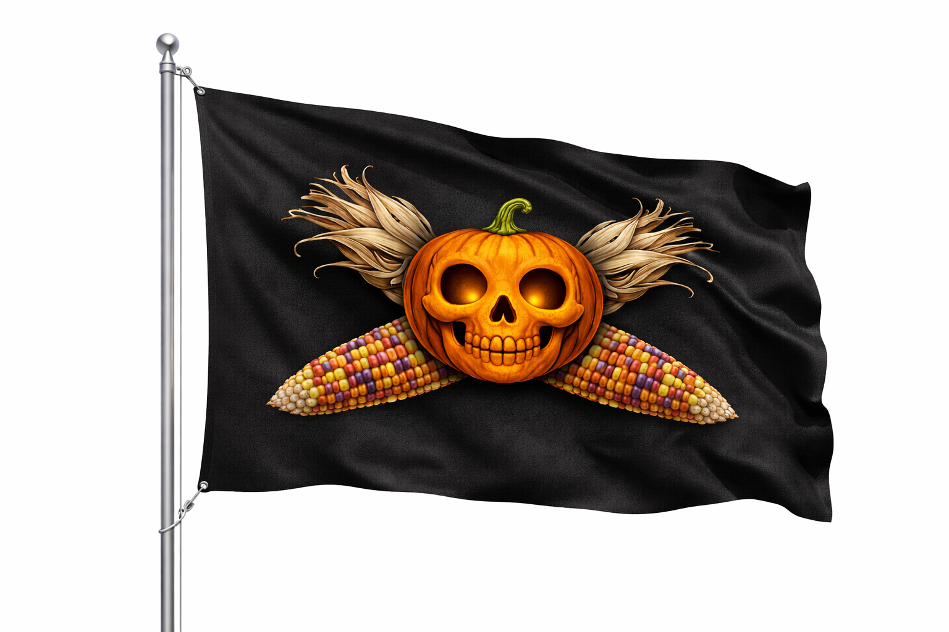
Fill the treasure pumpkin
FINE MOTOR
Drag the orange dots into the pumpkin. Count how many you use.
PUMPKIN
TREASURE
First Church Port Orange • 2026
Pumpkins are the treasure!
Notes:
Interactive pieces remain editable and movable in PowerPoint Normal view.

Slide 16
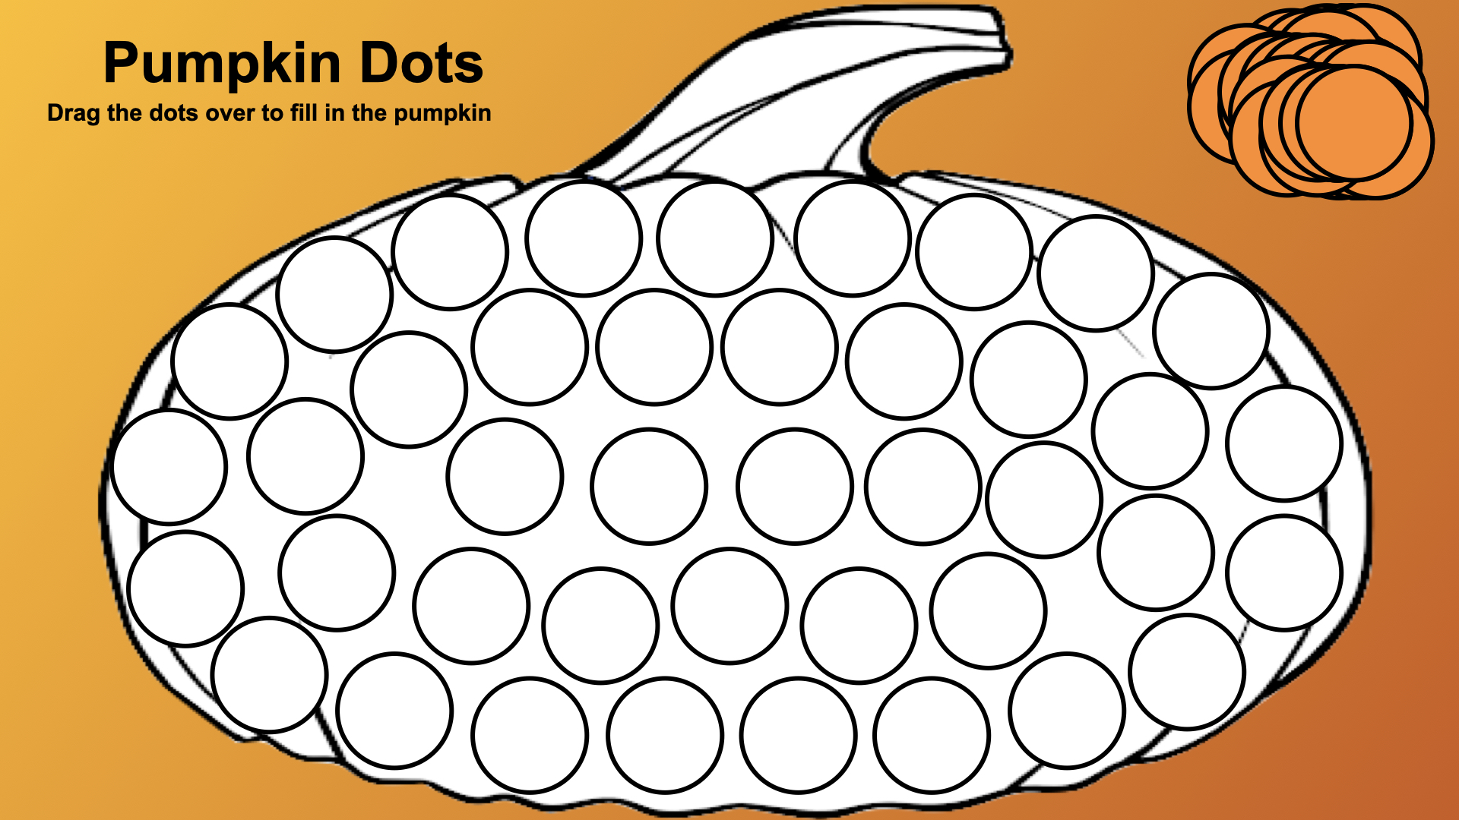

Slide 17
Compare two treasure chests
PUMPKIN MATH
Build two pumpkin groups. Drag the correct sign between them: < = >
CHEST A
CHEST B
4
5
<
7
8
9
10
=
>
1
2
6
3
First Church Port Orange • 2026
Pumpkins are the treasure!
Notes:
Interactive pieces remain editable and movable in PowerPoint Normal view.

Slide 18
Count the treasure by tens
PUMPKIN MATH
Each pumpkin chest holds 10 seeds. Drag one coin onto each chest and count 10, 20, 30…
10
10
10
10
10
10
20
30
40
50
10
10
10
10
10
60
70
80
90
100
First Church Port Orange • 2026
Pumpkins are the treasure!
Notes:
Interactive pieces remain editable and movable in PowerPoint Normal view.

Slide 19
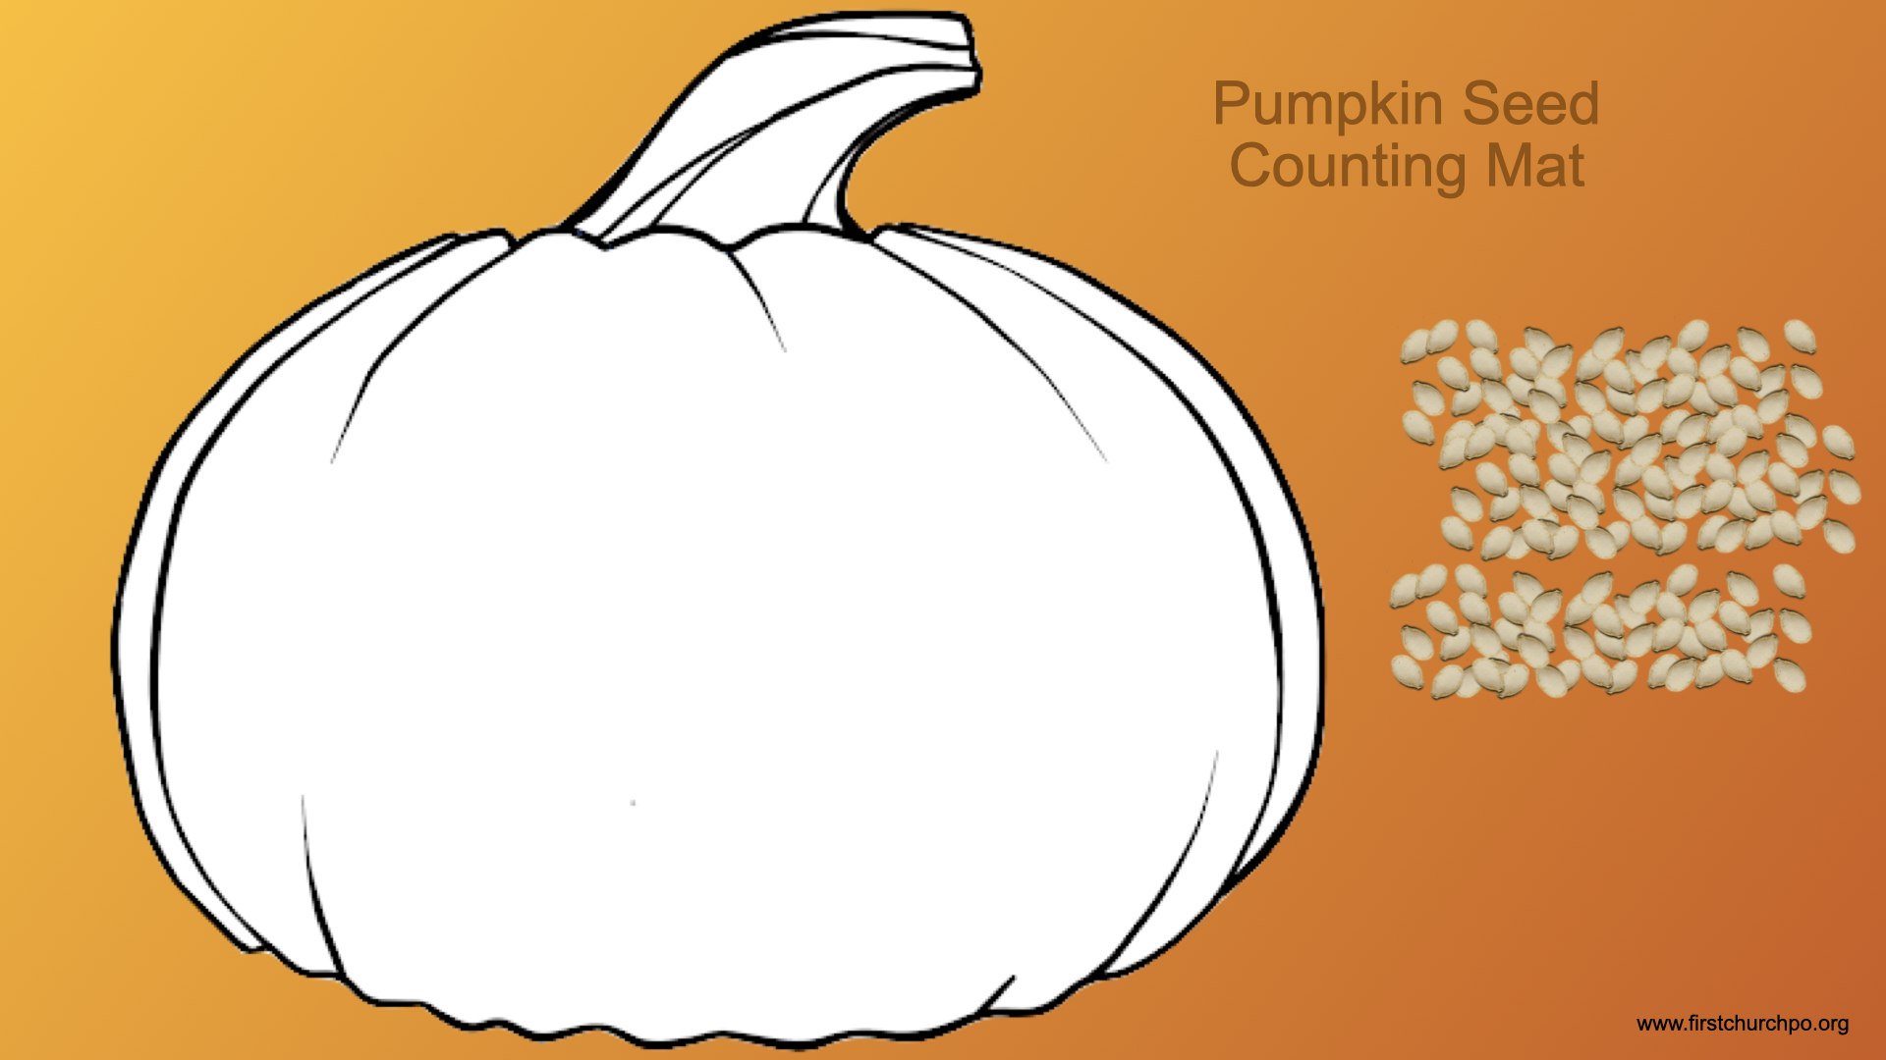

Slide 20
How many seeds in the treasure?
COUNT + ESTIMATE
Estimate the seeds first. Then drag seeds into groups of five and count the total.
COUNTING AREA
My estimate: ______
My count: ______
Difference: ______
First Church Port Orange • 2026
Pumpkins are the treasure!
Notes:
Interactive pieces remain editable and movable in PowerPoint Normal view.

Slide 21
Draw your pumpkin treasure
PUMPKIN WRITING
Add labels for color, shape, stem, and texture.
DRAW HERE
My labels
color: __________________
shape: __________________
stem: __________________
texture: __________________
First Church Port Orange • 2026
Pumpkins are the treasure!
Notes:
Interactive pieces remain editable and movable in PowerPoint Normal view.

Slide 22


Slide 23


Slide 24


Slide 25
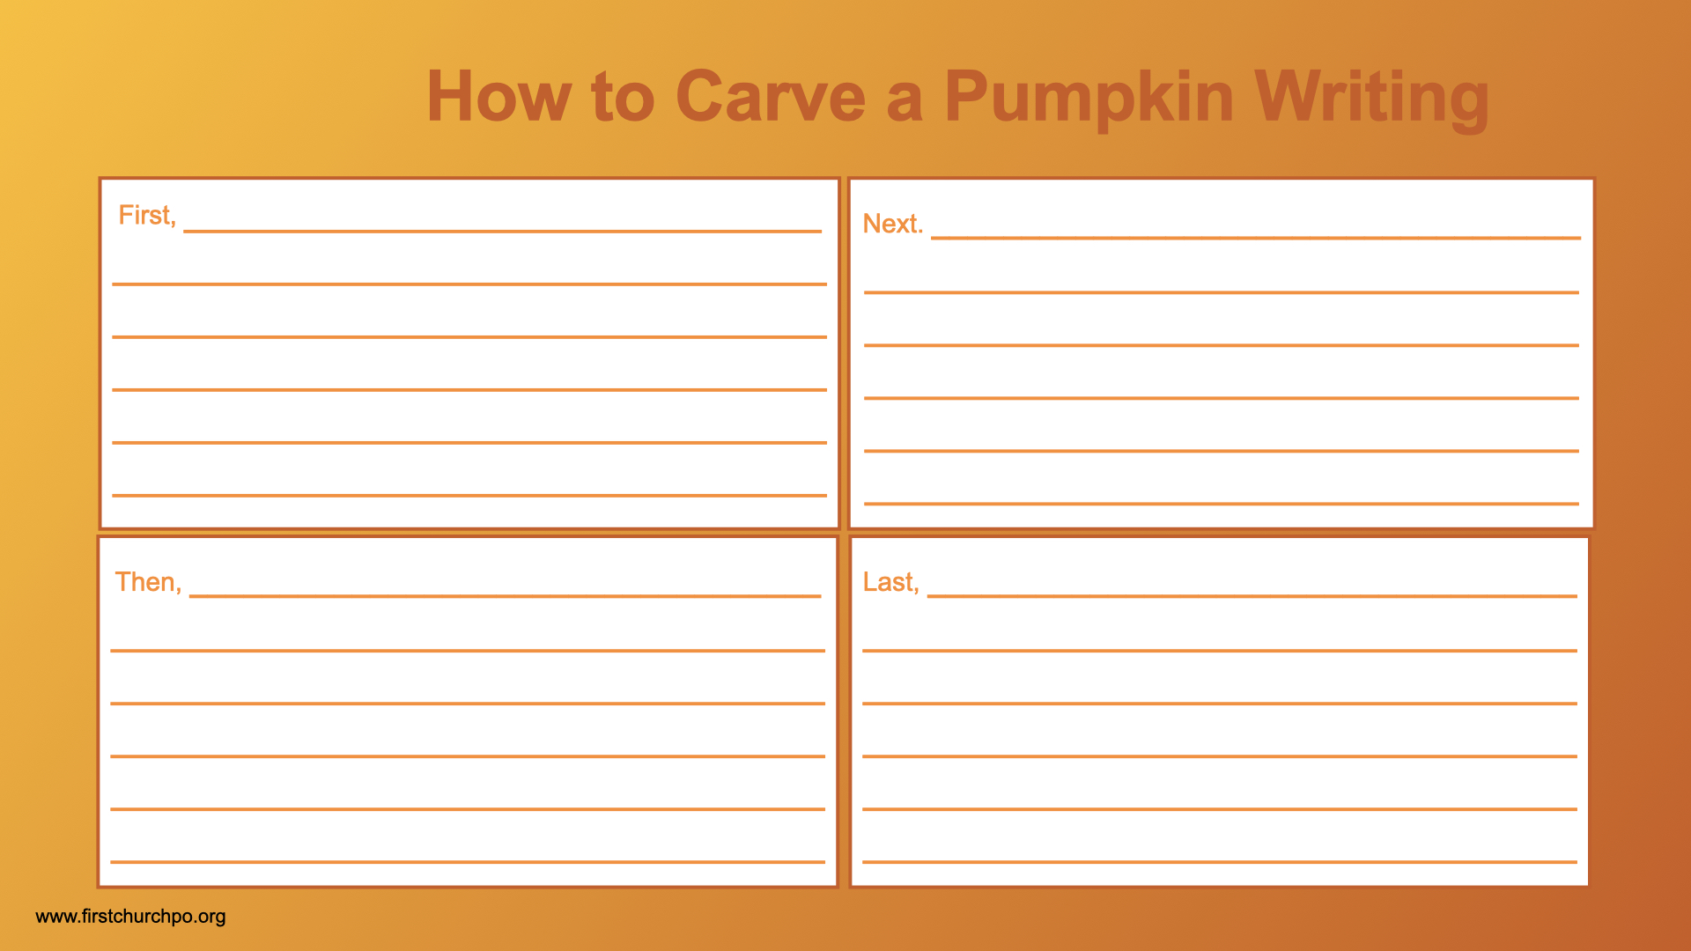

Slide 26
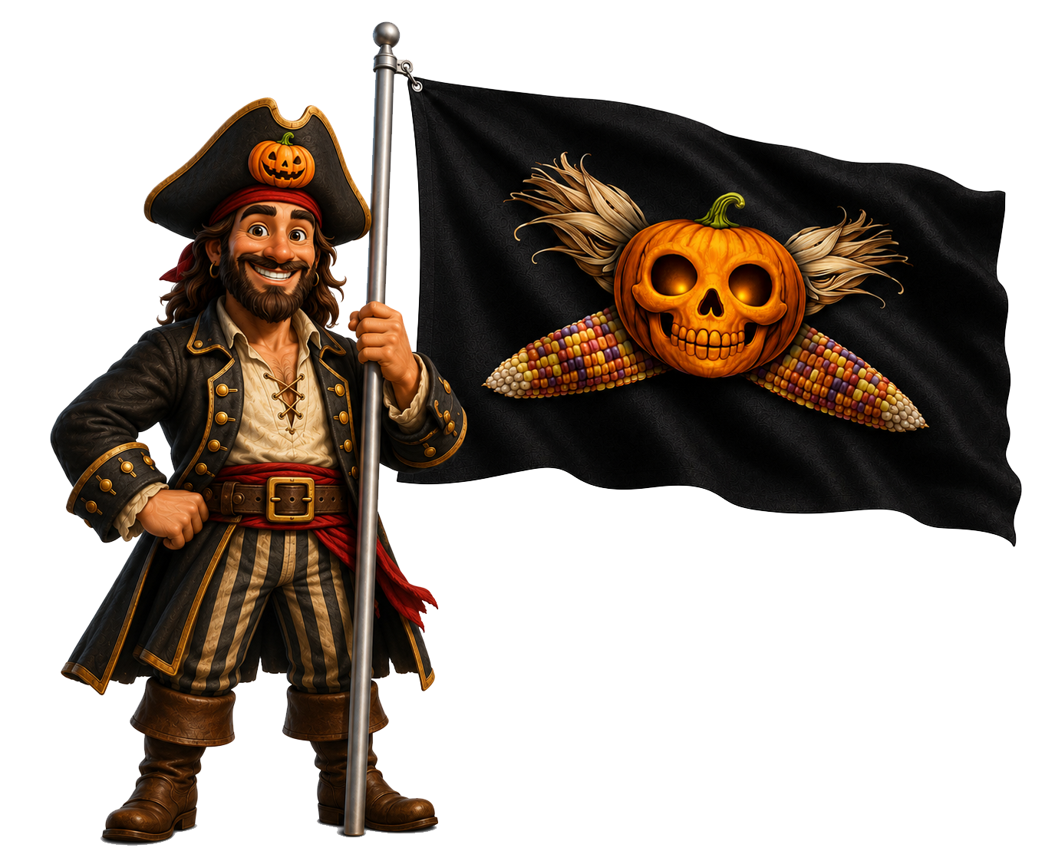
How to carve a pumpkin: Written directions
SEQUENCE WRITING
Write the four steps using first, next, then, and last.
FIRST
NEXT
THEN
LAST
First Church Port Orange • 2026
Pumpkins are the treasure!
Notes:
Interactive pieces remain editable and movable in PowerPoint Normal view.

Slide 27
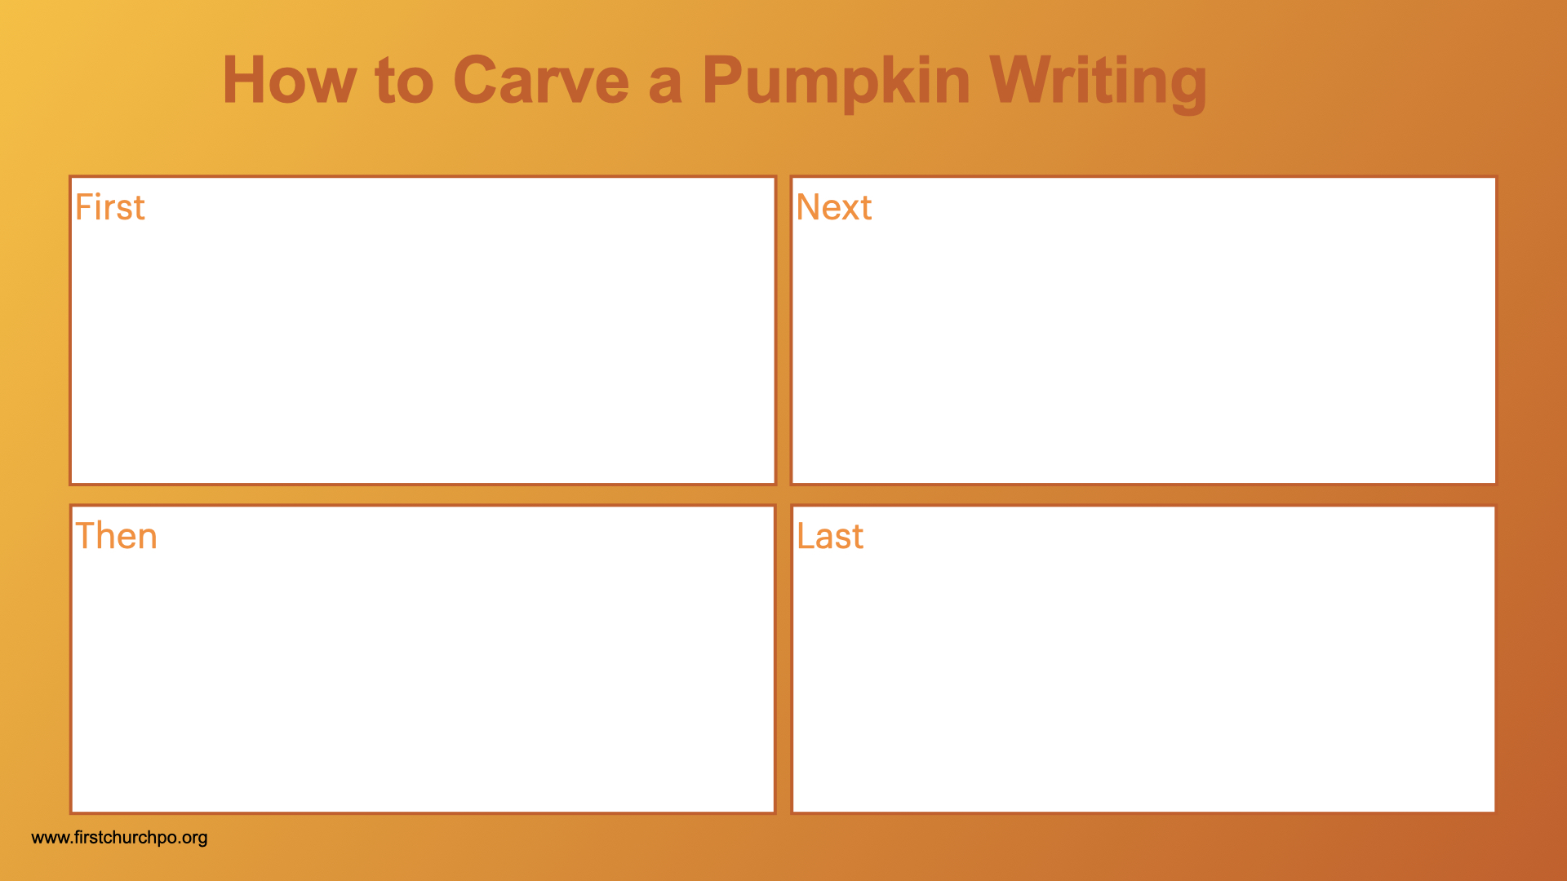

Slide 28
